Slide 1

EPICS PROJECT TOPIC: HOSPITAL MANAGEMENT SYSTEM PRESENTED BY: GROUP 281 SUPERVISOR: MRS. JAYANTHI J REVIEWERS: DR.ANIL KUMAR YADAV AND DR.SUNEET JOSHI

Slide 2

Hospital Management system

Slide 3
The problem:
Current hospital management systems face multiple challenges that impede efficient operations and compromise the quality of patient care. These issues include disjointed systems leading to inefficiencies, the absence of real-time information causing delays in decision-making, data silos resulting in redundancy and accessibility obstacles, insufficient analytics capabilities hindering informed decision-making, and concerns regarding security and compliance. These problems collectively undermine the effectiveness of resource allocation, patient care delivery, and timely decision-making within healthcare facilities.

Slide 4

Scope of the project:
SCOPE of the project
The project encompasses the development of a comprehensive system designed to streamline hospital operations by integrating MongoDB Atlas Realm technologies. This includes functionalities to facilitate real-time data access, seamless information flow, and analytics-driven insights. The system aims to manage patient records and billing while ensuring scalability, reliability, and data security. The scope involves implementing a user-friendly interface, real-time data synchronization, analytics dashboards, and stringent security measures compliant with healthcare regulations. The focus extends to empowering efficient healthcare delivery, informed decision-making, and adaptable system scalability to meet evolving industry needs.
4

Slide 5

Features
Record patients data
Search or view the data
Updates the data
Delete the data
Real time data analyzing through the Admin page

Slide 6
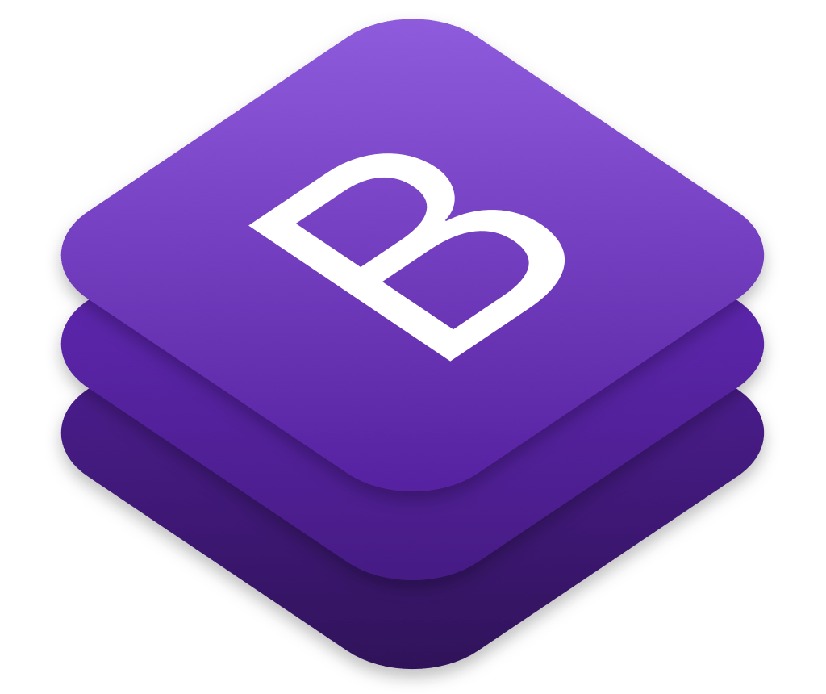

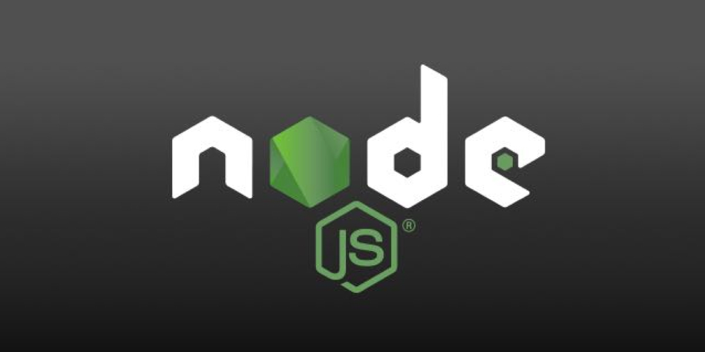

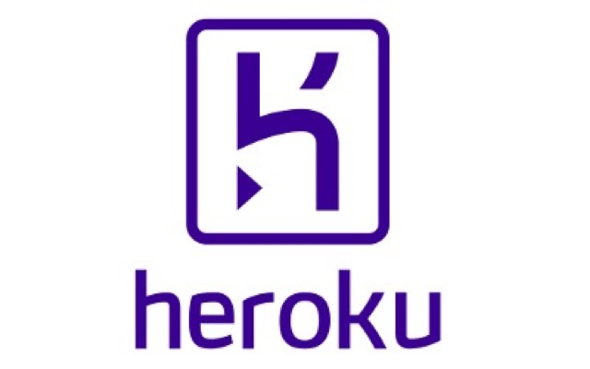
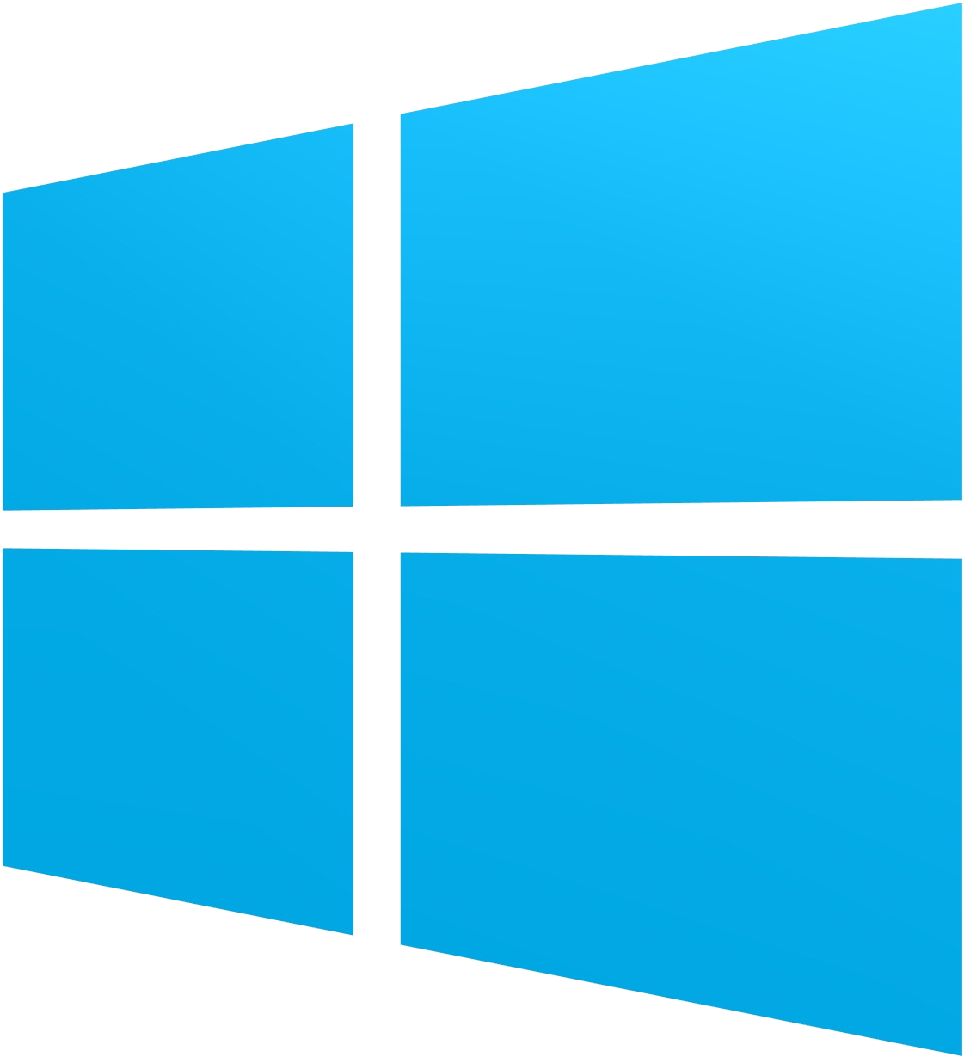
Requirements :
Hardware:
At least 4GB RAM
Multi-core CPU
Hard-disk (for storage)
Software:
Bootstrap
JavaScript
NodeJS
MongoDB
Mongoose
Heroku

Slide 7
Architecture diagram

Slide 8


GRAPHIC USER INTERFACE
The project is still under the wraps ...

Slide 9
DEMO VIDEO
We’ll Be Back...

Slide 10
USABILITY/APPLICATIONS
Hospital Management system assists in managing patient demographics, appointments, admission, discharge, and transfer (ADT). It also includes tracking patient medical history, diagnoses, treatment plans, and medications.
It also helps maintains a digital record of patient health information, including medical history, test results, diagnoses, medications, and treatment plans. This information is accessible to authorized healthcare providers.

Slide 11
THANK YOU.

